Slide 1



Module I 10-minute coaching

Slide 2
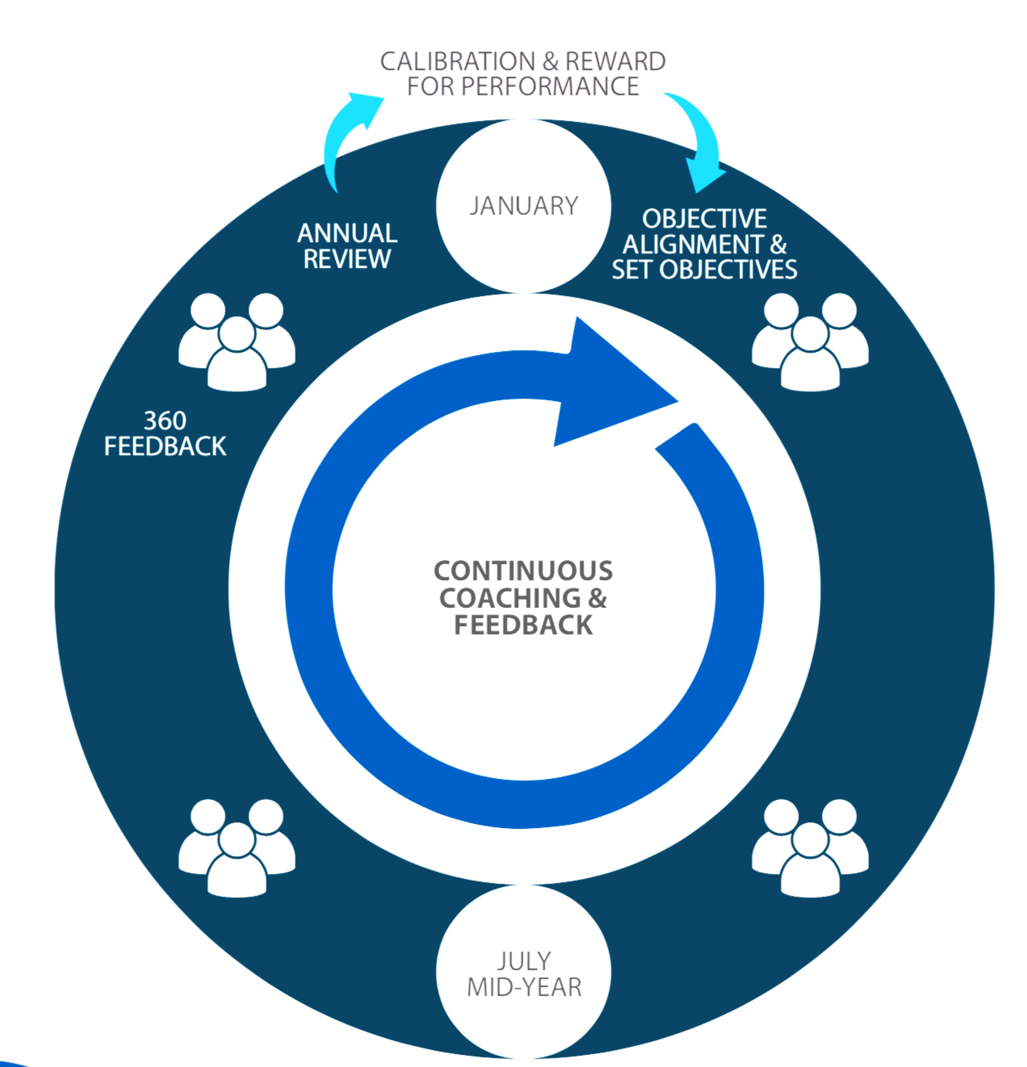

Building just-in-time PM capability
HIRING FOR FIT & POTENTIAL
1 day
MODULE IV: CONFLICT RESOLUTION THAT WORKS
90 min
MODULE V: SETTING GOALS
90 min
MODULE I: 10-MINUTE COACHING
90 min
(post-survey)
ENGAGING
FOR TEAM PERFORMANCE
2 hrs
MODULE II
POWERFUL FEEDBACK
90 min
(pre-survey)
BUILDING ENGAGEMENT THROUGH TRUST
2 hrs
MODULE III GROWING OUR PEOPLE
90 min
Notes:
The modules contain all the essential skills you need to support the performance of your people.
Training will be done just-in-time.

Slide 3



intense
timed
tasters
Notes:
What is the main advantage of drinking espresso instead of americano? It takes less time.
These four sessions are like drinking shots of espresso.
First of all, it’s INTENSE. The content has been condensed from roughly four days into four small chunks to save busy managers’ time. Plus research shows that intense bursts of learning are just as effective as long training sessions.
The trade-off is that we will STRICTLY TIME all activities so that we can deliver the sessions in the short time allotted. Remember we will be learning just as much as if we spent all day discussing these frameworks and research.
The activities are meant to be TASTERS. If you only manage to go through three questions out of eight, that’s absolutely fine. The exercises will give you enough of a taster to get you started. It’s important to apply what you have learned right after the session, and we will support you.

Slide 4
Agenda for today
Understand the mindset of a Coachee through SCARF
Exploring the 10-minute coaching conversation Model
Notes:
Today we’ll discuss what coaching is and why it’s important.
Then I’ll walk you through a simple way of having a short but meaningful coaching conversation.

Slide 5

5
Take a deep breath …
Reflect: who was the best coach you’ve had?
What made him or her best?

Slide 6


why coaching?
Notes:
First of all, let’s establish why coaching is one of the most powerful leadership tools – what coaching is and what it is not.

Slide 7
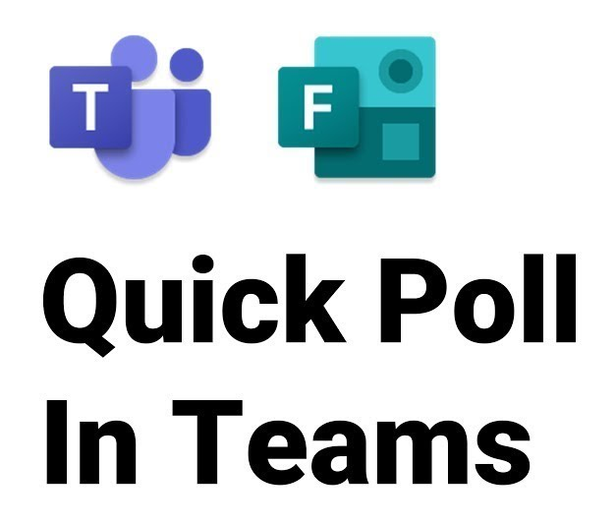
why coaching?
Notes:
Either Do a poll on MS Teams or a match the following on Nearpod What does coaching, and feedback curtail and focus on?

Slide 8


feedback
coaching
8
past behaviour
future
behaviour
evaluate & correct
develop
tell
ask & help
find own way
Notes:
People are often confused about the definition of coaching and how it differs from feedback.
While there may be some overlap, these are two very distinct methods of interaction.
There is a difference in FOCUS, PURPOSE, and MEANS.
The FOCUS of feedback is on past behaviour. The FOCUS of coaching is on future behaviour.
The PURPOSE of feedback is to evaluate and correct. The PURPOSE of coaching is to develop.
The MEANS of feedback is by telling. The MEANS of coaching is by asking and helping a person to find their own way.
Both tools are important, and every leader needs to have both in their toolkit. We WILL discuss feedback in much more detail in one of our later modules..
It is also important to note that sometimes we use the term ‘coaching’ in a negative sense, i.e if someone is underperforming, we say “he needs coaching”. However, coaching is a very POSITIVE TOOL that can be used for people’s growth, development, and problem-solving in almost all situations. What we want to say very clearly here is: we believe that coaching should be the PRINCIPLE TOOL of the manager and should be used much more frequently than corrective feedback.

Slide 9
Key Learning points
How did coaching reach the workplace?
Counselling
Coaching
Focus on Past
Passive Orientation
Pathology Orientation
Strict confidentiality
Meetings of Variable length
Rigid boundaries
Resolve personality issues
Focus on Future
Action Orientation
Growth of Skill Orientation
Information can be shared with care
Flexible boundaries , social settings
Work around personality issues
Corporate COE of L&OD

Slide 10
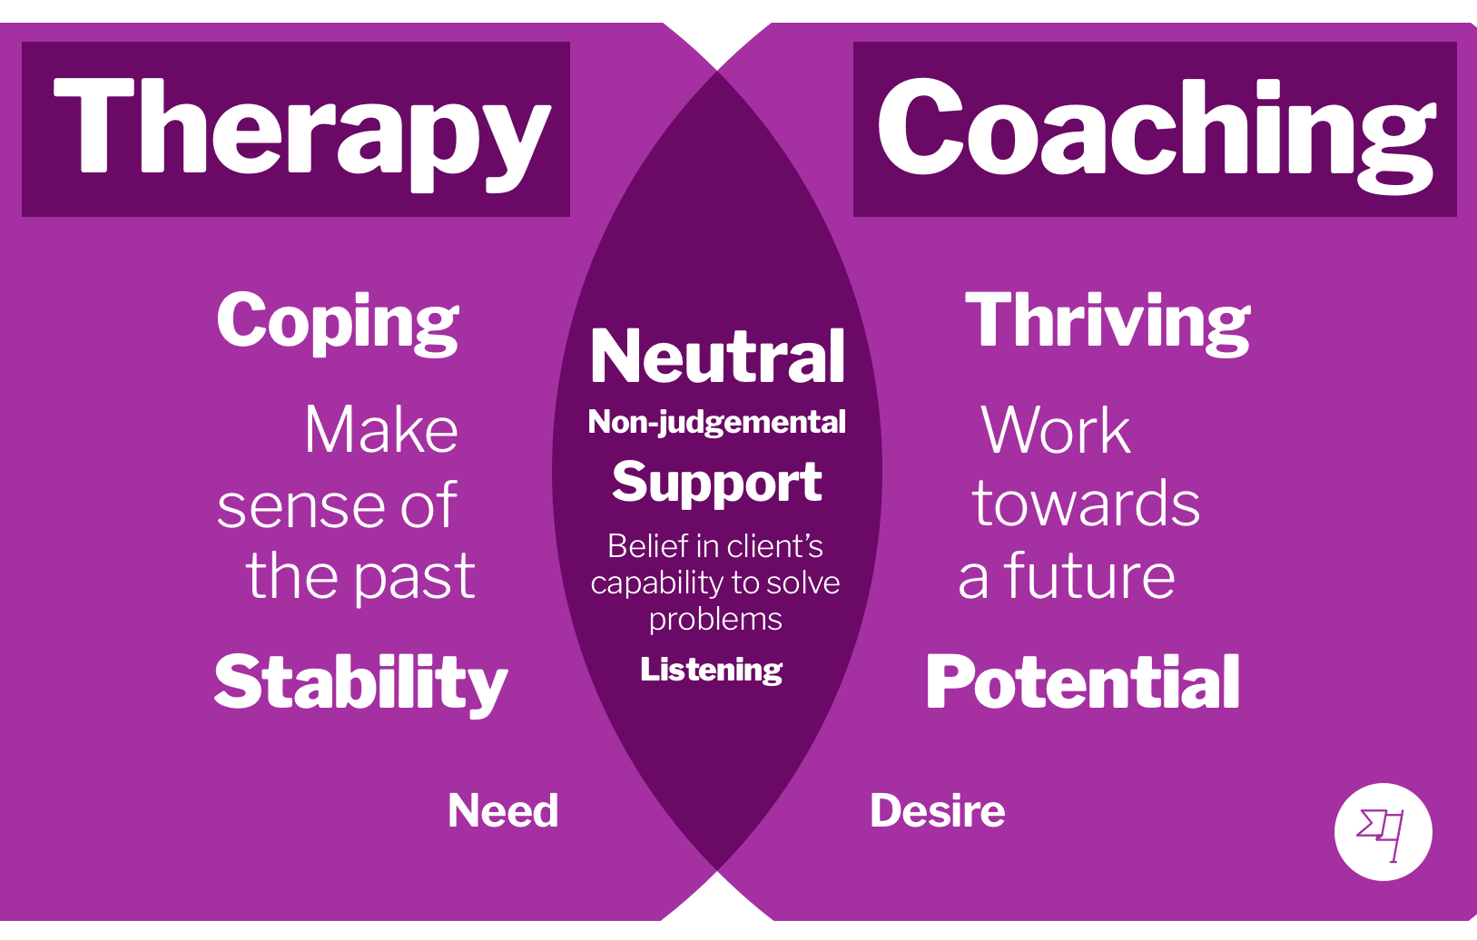

Slide 11
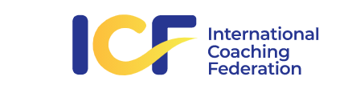

Definition of Coaching
“Partnering with employees in a thought-provoking and creative process that inspires them to maximize their personal and professional potential.
A professionally guided process that inspires employees to maximize their personal and professional potential. It is a structured, purposeful and transformational process, helping them to see and test alternative ways for improvement of competence, decision making and enhancement of quality of life. Coach establishes confidential terms.
European Mentoring and Coaching Council

Slide 12
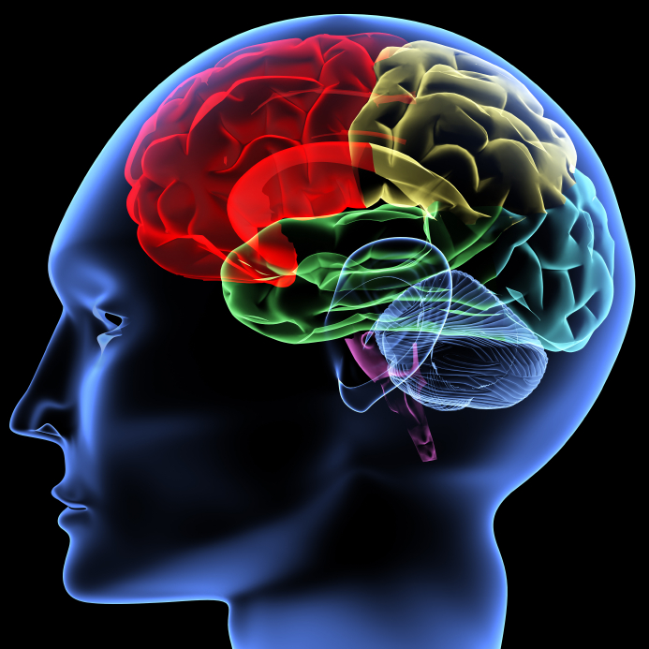
why ‘telling’ doesn’t work very well
Limbic system
prefrontal cortex
Notes:
The reason is that constantly telling people what to do does not work. Here’s why.
Here is how the human brain works. Prefrontal cortex is a very important part of the brain that is responsible for making decisions, and yet is very energy-hungry, weak, and capricious.
It is very easy to upset it– if you expose your brain to any physical threat, the fight-or-flight system of the brain is activated. Brain resources flow in to support it, and as a result prefrontal cortex cannot function well, so we literally become dumb.
So here’s the key point: it seems that our brain cannot differentiate between PHYSICAL threat and SOCIAL threat.
When we tell people what they should do, they feel defensive. When people feel defensive, they don’t think straight.

Slide 13
our brains treats social threats in the same way as physical ones
S
tatus am I more, less or as important as you are?
ertainty do I know what will happen to me?
utonomy do I have a say or not?
elatedness are you my friend or foe?
airness will you be fair to me?
C
A
R
F
Adapted from David Rock, “Your Brain at Work”, Harper Business, 2009
Notes:
David Rock helpfully mapped out the five domains of social experience that create a threat response, using the acronym SCARF.
Our brain’s most important function is to keep its owner safe. So it constantly scans the environment, looking for potential threats.
(Explain each.)
Now, what happens if my boss is constantly telling me what I’m doing wrong and what I should be doing instead? Which elements of the SCARF are under threat? Most if not all of them (ESPECIALLY STATUS).
As a result, I feel ‘less than’, overwhelmed, and I can’t make rational decisions.
So, while telling people what they should do is sometimes important, it should not be our main way of managing people.

Slide 14

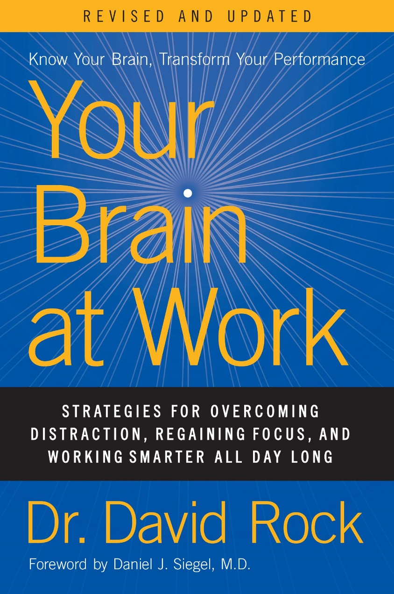
our brain treats Social Threats in the same way as Physical ones
Status
am I more, less or as important as You are?
Certainty
do I know what will happen to me?
Autonomy
do I have a say or not?
Relatedness
are You my friend or foe?
Fairness
will You be fair to me?
David Rock, “Your Brain at Work” Doctorate in the Neuroscience of Leadership
Notes:
David Rock helpfully mapped out the five domains of social experience that create a threat response, using the acronym SCARF.
Our brain’s most important function is to keep its owner safe. So it constantly scans the environment, looking for potential threats.
(Explain each.)
Now, what happens if my boss is constantly telling me what I’m doing wrong and what I should be doing instead? Which elements of the SCARF are under threat? Most if not all of them (ESPECIALLY STATUS).
As a result, I feel ‘less than’, overwhelmed, and I can’t make rational decisions.
So, while telling people what they should do is sometimes important, it should not be our main way of managing people.

Slide 15

constant telling also…
15
creates dependency
inhibits learning
promotes manager’s burnout

Slide 16
time to recall
Fill-in the
Blanks

Slide 17

why coaching is a better way to help people grow
17
it encourages people to
focus on the solution
make their own choices
find their own answers
Notes:
So, why is coaching a better way to change someone’s behaviour?
Why don’t we do it all the time then? (Listen to opinions.)

Slide 18

18
coaching isn’t easy
Brainstorm
Notes:
There are two main reasons for that.
First, it just takes a LOT MORE TIME than telling someone what to do.
Secondly, it creates A THREAT to our own brain.
Resisting the temptation to solve the person’s problem ourselves can be difficult. (Imagine watching someone struggle with a jigsaw puzzle, seeing where the missing piece is, but not being allowed to say anything).
Threat to Status – what if the other person comes up with a good idea and show that s/he is smarter than me?
Threat to Certainty – what if the other person can’t find a solution?
Coaching doesn’t come naturally to most people. But it is definitely worth the effort.
So, if you struggle with coaching at the beginning, don’t give up!

Slide 19
19
coaching isn’t easy
but it’s worth the effort
Notes:
There are two main reasons for that.
First, it just takes a LOT MORE TIME than telling someone what to do.
Secondly, it creates A THREAT to our own brain.
Resisting the temptation to solve the person’s problem ourselves can be difficult. (Imagine watching someone struggle with a jigsaw puzzle, seeing where the missing piece is, but not being allowed to say anything).
Threat to Status – what if the other person comes up with a good idea and show that s/he is smarter than me?
Threat to Certainty – what if the other person can’t find a solution?
Coaching doesn’t come naturally to most people. But it is definitely worth the effort.
So, if you struggle with coaching at the beginning, don’t give up!

Slide 20

a 10-minute
coaching conversation
Notes:
So, coaching should be a manager’s staple tool.
Unfortunately, it’s impossible to train someone to be a coach in one hour.
The International Coaching Federation, for example, requires 60 hours of training and 100 hours of coaching practice just to get the Associate Coach Certification. To get their Professional Certification, you need 125 hours of training and over 500 hours of practice.
We’d like to provide you with a very simple yet powerful framework for having short coaching conversations with your people. In the next hour we’ll give you enough to go ahead and start practicing.

Slide 21

Coaching scene movie
Notes:
Introduce the GROW model without talking about it through a video clip from the movie, How to train my dragon? This get’s them to start thinking in the direction of the Grow Coaching model.

Slide 22
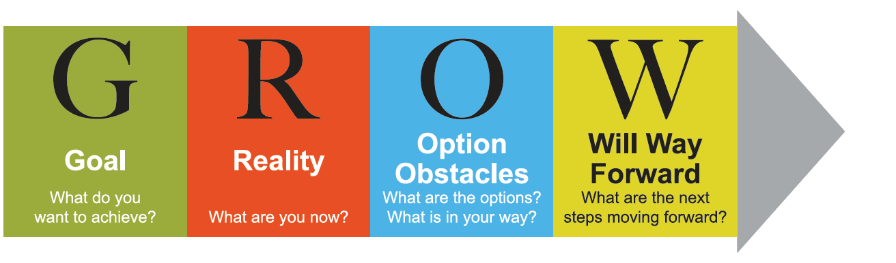
GROW Model for Coaching Conversations
The GROW Model

Slide 23
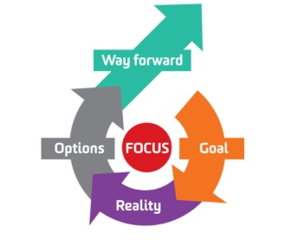
What is Coaching Essentials ?
10 Minute Coaching
A Coaching Model should focus on getting the best from others and increasing their engagement and ownership of tasks. One of the most popular and effective models for practical coaching is GROW.
It helps line managers create a mindset and equips them with essential skills, and a structured process for Coaching during an appraisal discussion.
Corporate COE of L&OD

Slide 24
Using the GROW Model during an Appraisal
Using the GROW model during a Performance Conversation
To help appraise self discover instead of ‘telling’, can often help the individual agree on Goals, skills , attitude or knowledge required.
Helps appraise identify steps required to achieve rather than manager
telling them what to do.
Helps appraiser better establish SMART objective for goals / projects
Corporate COE of L&OD
Notes:
Show GROW model in 90 seconds

Slide 25
GOALS
The GROW model starts with establishing a goal. It could be a performance goal, a developmental goal, a problem to solve or a decision to make.
Goals
Goals
What is it you would like to focus on?
How would you know you were being successful if you achieved your goal?
Goals
What would you like to achieve
Goals
How could you break this goal down into manageable chunks?
Goals
What would you like to happen that is not happening now
Goals
What are all the things that would need to be done to achieve the goal?

Slide 26
REALITY
Helps you and your employee gain awareness of the current situation. The key is to take it slowly with your questions –
A
B
What is happening at the moment to derail your progress toward the goal?
What other factors are relevant and who else is relevant? When and how does this happen?
What is that person’s perception of the situation? What have you tried so far?
What else is conflicting with achieving this goal?
D
You need to allow for thinking time. Let the employee think about the question and reflect on his or her answers.
C

Slide 27
OPTIONS
OPTIONS
OPTIONS
What possibilities for action do you see? Don’t worry about how realistic they are at this stage
What are the benefits and pitfalls of these options?
OPTIONS
OPTIONS
Which options are of interest to you?
Who might be able to help you?
OPTIONS
OPTIONS
Which options do you like the most?
Rate from 1 to 10 your
assessment of the practicality of each of these options
Notes:
Coaching For Poor Performance
Show the video on Poor Performance and then pause till the situation where the operator makes the mistake and ask two volunteers to pair up and do a role play of proving coaching related feedback.
Ask the class to make observations on the roleplay in the roleplay sheet. Then follow up with the remaining part of the video

Slide 28
WILL
This is the last step in the GROW model. In this step, the manager/appraiser checks for commitment and helps the team establish a clear action plan for next steps.
WILL
WILL
What are your next steps?
Precisely when will you take Them?
WILL
WILL
WILL
What might get in the way?
What support do you need?
Can you see some real benefit coming from this for yourself and others?
Are you excited by the prospect?
Notes:
Show Best Coaching Conversation Video from How to Train your Dragon movie

Slide 29
Video insights – Coaching
Problem solving | One to Ones
Corporate COE of L&OD
Notes:
Show video corridor coaching, where a manager uses limited time to coach in an informal setting

Slide 30
GROW Coaching Model
Corporate COE of L&OD
Notes:
Show the GROW coaching model video summarizing the GROW

Slide 31
closing comments
Brainstorm

